Slide 1
How to Run Applications Fasters?
There are 3 ways to improve performance
Work harder
Work smarter
Get help
Computer analogy
Use faster hardware : e.g., reduce the time per instruction (clock cycle)
Optimize algorithms and techniques, customized hardware
Multiple computers to solve the problem = to increase no. of instructions executed per clock cycle

Slide 2
Sequential Architecture Limitations
Sequential architectures reaching physical limitation
Hardware improvements like pipelining, superscalar, …., are not scalable and require sophisticated compiler technology
Vector processing works well for certain problems
=> Technology push!

Slide 3
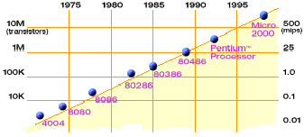
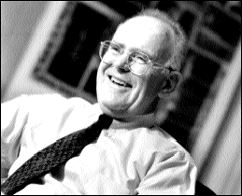
Technology Trends: Microprocessor Capacity
Moore’s Law
2X transistors/Chip Every 1.5 years
Called “Moore’s Law”
Gordon Moore (co-founder of Intel) predicted in 1965 that the transistors density of semiconductor chips would double roughly every 18 months.
Microprocessors have become smaller, denser, and more powerful.

Slide 4




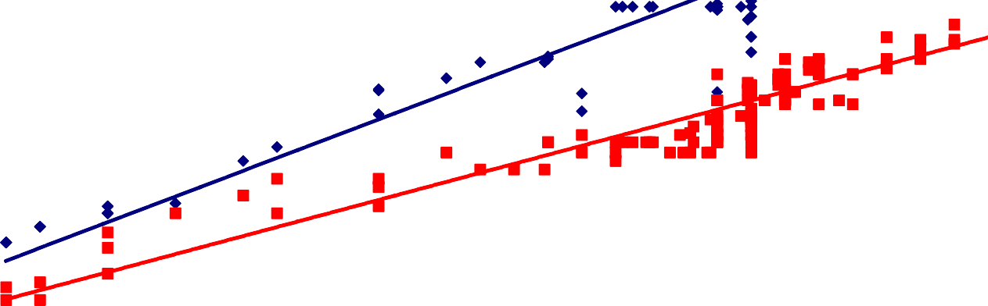




Microprocessor (1970-2000)
10000000
1000000
Transistors (Thousands)
100000
Frequency (MHz)
10000
1000
100
10
1
0
1970
1975
1980
1985
1990
1995
2000

Slide 5
Hidden Parallelism Tapped Out
In the past: increasing circuit density to performance
Microprocessors - Superscalar designs were the state of the art :
What is superscalar?
Dynamic scheduling
Speculative execution
Non-blocking caches
Apparent path to higher performance?
Wider instruction issue
Support for more speculation
Unfortunately, these sources have been used up!

Slide 6
Hidden Parallelism Tapped Out
Unfortunately, these sources have been used up!
Two factors:
Fundamental circuit limitations
delays ⇑ as issue queues ⇑ & multi-port register files ⇑
Increasing delays limit performance returns from wider issue
Limited amount of ILP
• ?
“The case for a single-chip multiprocessor”, K. Olukotun, B. Nayfeh,
L. Hammond, K. Wilson, and K. Chang, ASPLOS-VII, 1996.

Slide 7
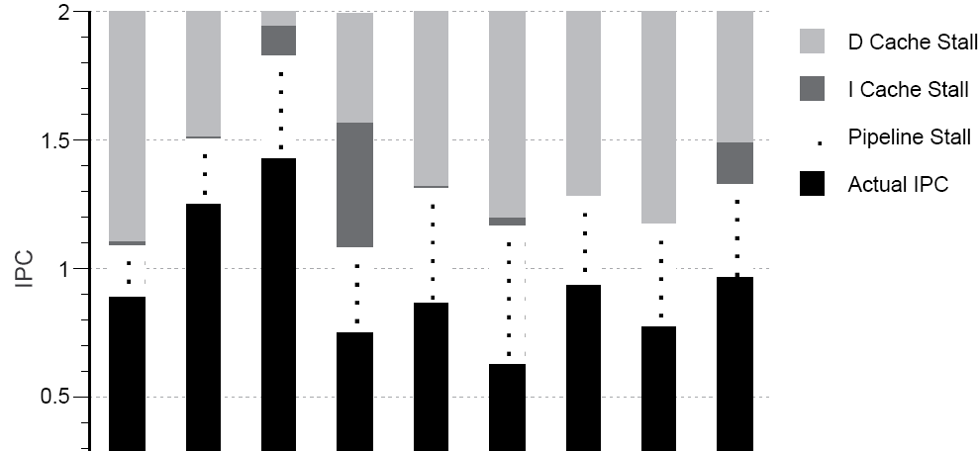
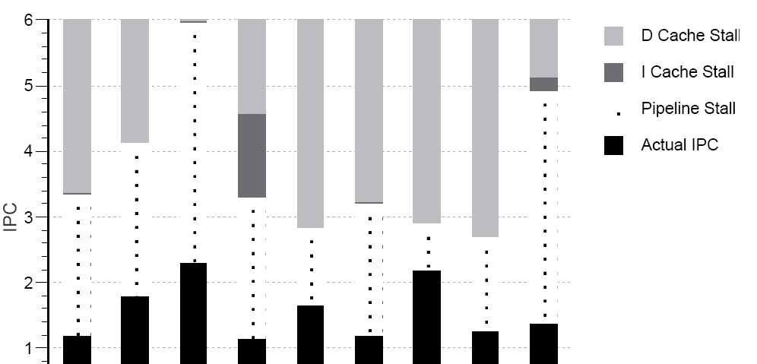
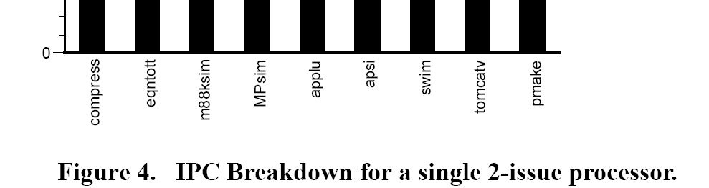
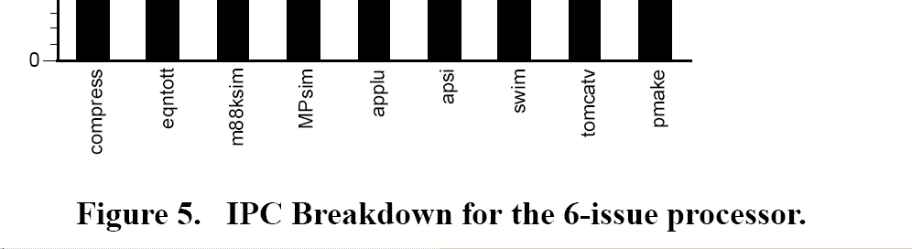
Performance Comparison
The 6-issue has higher IPC than 2-issue, but far less than 3x
Possible reasons??

Slide 8
Impact of Device Shrinkage
What happens when the feature size (transistor size) shrinks by a factor of x ?
Clock rate goes up by x because wires are shorter
actually less than x, because of power consumption
Transistors per unit area goes up by x²
Die size also tends to increase
typically another factor of ~x
Raw computing power of the chip goes up by ~ x⁴ !
typically x³ is devoted to on-chip
So most programs x³ times faster, without changing them

Slide 9
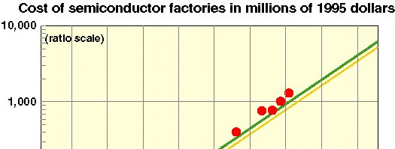

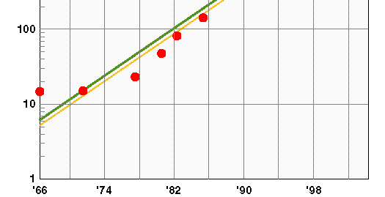

Manufacturing Issues Limit Performance
Manufacturing costs and yield problems limit use of density
Moore’s 2nd law (Rock’s law): ??
Demo of 0.06
micron CMOS
Source: Forbes Magazine
Yield
-What percentage of the chips are usable?
-E.g., Cell processor (PS3) is sold with 7 out of 8 “on” to improve yield

Slide 10


Power Density Limits
Scaling clock speed (business as usual) will not work
Concurrent systems are more power efficient
– Why??
10000
Sun’s Surface
Rocket
Source: Patrick Gelsinger, Shenkar Bokar, Intel®
1000
Nozzle Nuclear
Power Density (W/cm²)
100
Reactor
8086
Hot Plate
10
4004
P6
8008
8080
8085
286
386
Pentium®
486
1
1970
1980
1990
Year
2000
2010
High performance serial processors waste power
Speculation, dynamic dependence checking, etc. burn power
Implicit parallelism discovery
More transistors, but not faster serial processors

Slide 11

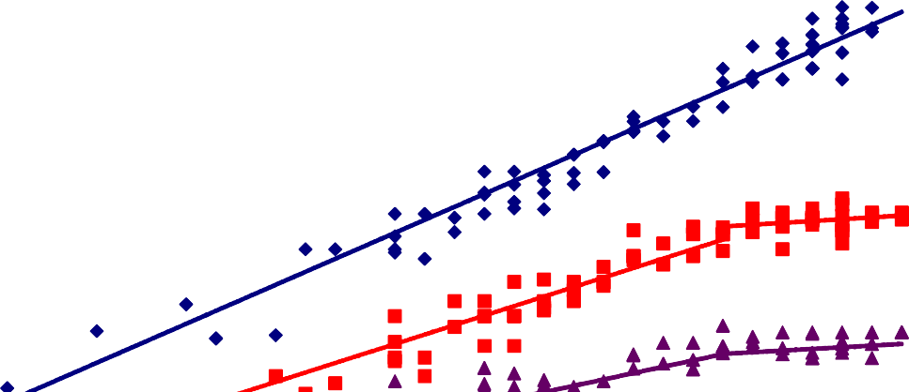

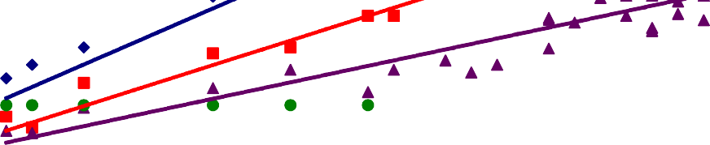

Revolution in Processors
10000000
1000000
Transistors (Thousands) Frequency (MHz)
Power (W) Cores
100000
10000
1000
100
10
1
0
1970 1975 1980 1985 1990 1995 2000
Chip density is continuing increase ~2x every 2 years
Clock speed is not
Number of processor cores may double instead
Power is under control, no longer growing
2005
2010

Slide 12
Multicore Chips
Single core trends are gloomy
Performance is difficult to exploit
Perf/power deteriorate
Fill the die w/ cache has limited value
Between 2MB and 4MB cache – gain is diminishing
Solution: more cores on a die
Benefits: higher performance, constant perf/power, less complexity, lower wire delays
Challenges: scalability of interconnect, scalability of application, limited memory BW, power
Other solutions: more integration - memory controller, special functions/accelerators, graphics, …

Slide 13
all
Why powerful computers are
parallel
All major processor vendors are producing parallel computers, because ???

Slide 14
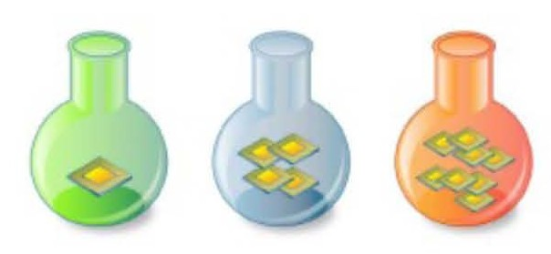
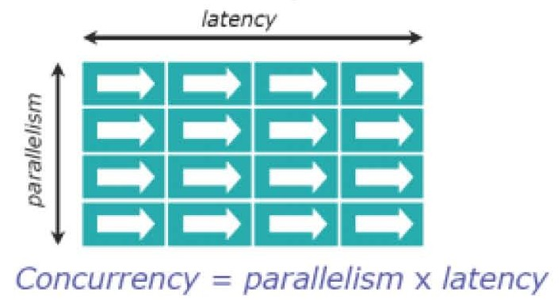
Memory Bottleneck
Cores share finite off-chip bandwidth
Latency cannot be improved significantly
It is already 100s of cycles
To hide latency, need more parallelism than number of cores, schedule data

Slide 15
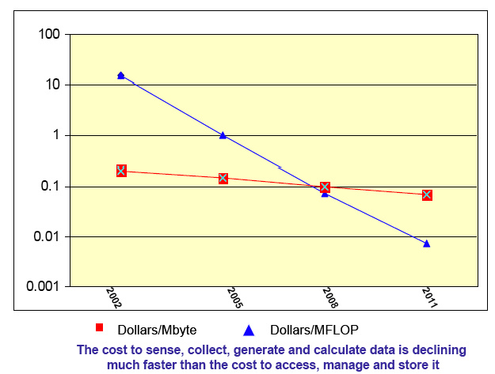
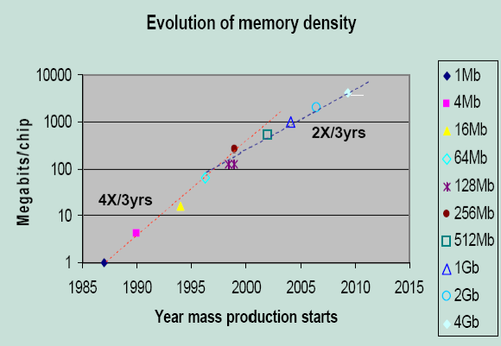
Memory is Not Keeping Pace
Technology trends against a constant or increasing memory per core
Memory density is doubling every three years; processor logic is every two
Storage costs ($/MB) are dropping gradually compared to logic costs
Cost of Computation vs. Memory
Source: David Turek, IBM
Source: IBM
Question: Can we double concurrency without doubling memory?
Strong scaling: ?
Weak scaling: ?
CS546

Slide 16
More Limits:
How fast can a serial computer be?
1 Tflop/s, 1 Tbyte sequential machine
r = 0.3 mm
Consider the 1 Tflop/s sequential machine:
Data must travel some distance, r, to get from memory to processor.
To get 1 data element per cycle, this means 10¹² times per second at the speed of light, c = 3x10⁸ m/s. Thus r < c/10¹² =
0.3 mm.
Now put 1 Tbyte of storage in a 0.3 mm x 0.3 mm area:
– Each bit occupies about 1 square Angstrom
No choice but parallelism

Slide 17
The TOP500 Project
Listing the 500 most powerful computers in the world
Yardstick: Rmax of Linpack
Solve Ax=b, dense problem, matrix is random
Dominated by dense matrix-matrix multiply
Update twice a year:
ISC’xy in June in Germany
SCxy in November in the U.S.
All information available from the TOP500 web site at: www.top500.org

Slide 18
Units of Measure in HPC
High Performance Computing (HPC) units are:
Flop: floating point operation
Flops/s: floating point operations per second
Bytes: size of data (a double precision floating point number is 8)
Typical sizes are millions, billions, trillions…
Mega
Mflop/s = 10⁶ flop/sec Mbyte = 2²⁰ = 1048576 ~ 10⁶ bytes
Giga Tera Peta Exa Zetta Yotta
Gflop/s = 10⁹ flop/sec Tflop/s = 10¹² flop/sec Pflop/s = 10¹⁵ flop/sec Eflop/s = 10¹⁸ flop/sec Zflop/s = 10²¹ flop/sec Yflop/s = 10²⁴ flop/sec
Gbyte = 2³⁰ ~ 10⁹ bytes
Tbyte = 2⁴⁰ ~ 10¹² bytes
Pbyte = 2⁵⁰ ~ 10¹⁵ bytes
Ebyte = 2⁶⁰ ~ 10¹⁸ bytes
Zbyte = 2⁷⁰ ~ 10²¹ bytes
Ybyte = 2⁸⁰ ~ 10²⁴ bytes

Slide 19
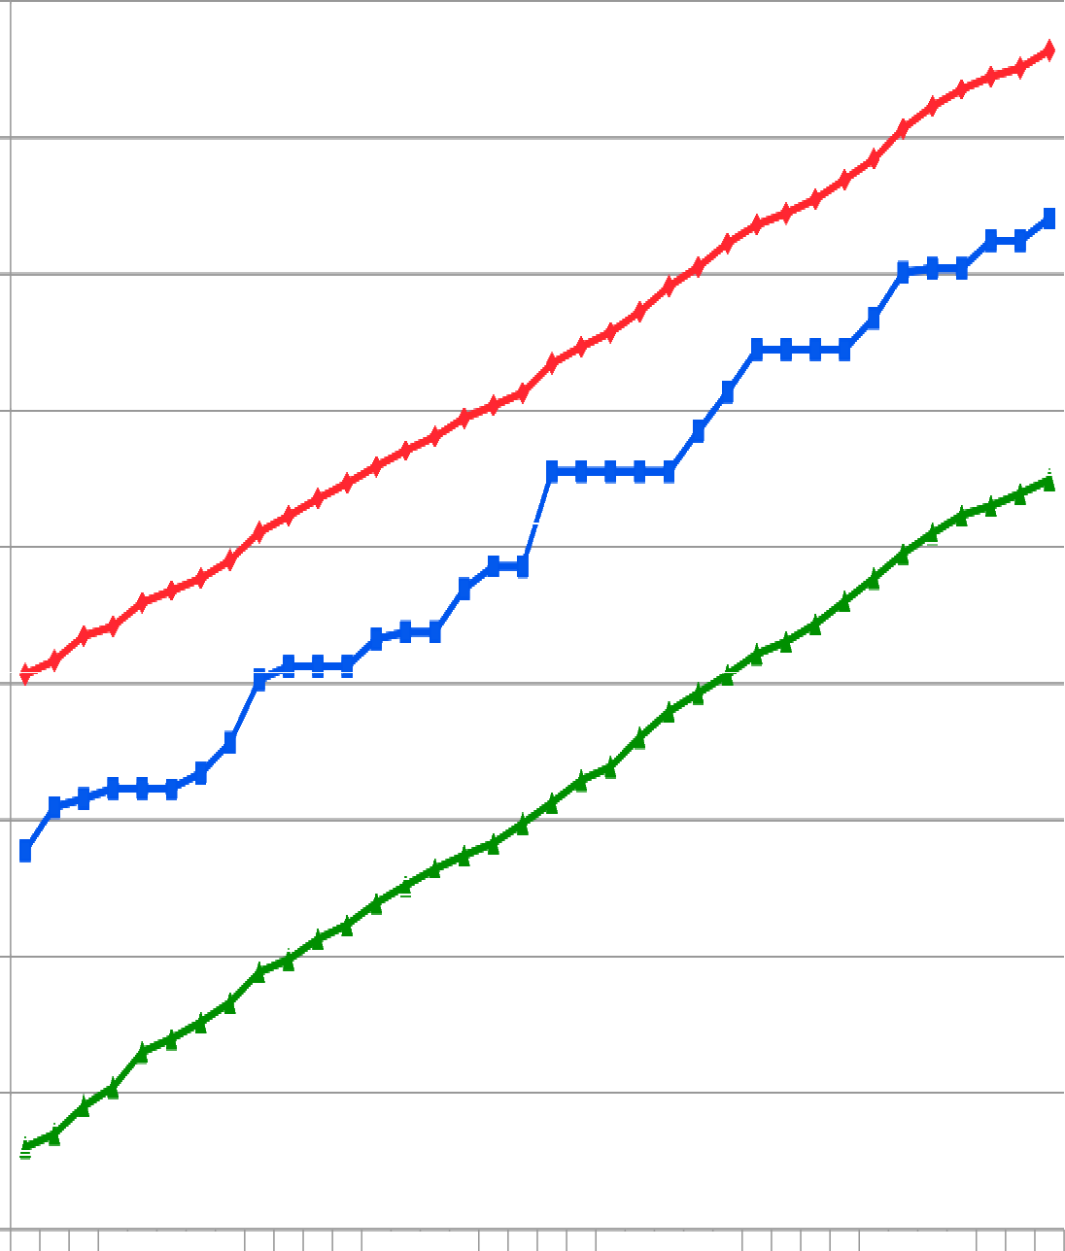

Performance Development
43.66 PFlop/s
100 Pflop/s
10 Pflop/s
2.57 PFlop/s
1 Pflop/s
100 Tflop/s
SUM
31.12 TFlop/s
10 Tflop/s
1 Tflop/s
N=1
1.17 TFlop/s
100 Gflop/s
59.7 GFlop/s
N=500
10 Gflop/s
1 Gflop/s
100 Mflop/s
400 MFlop/s

Slide 20



Core Count

Slide 21
Moore’s Law reinterpreted
Number of cores per chip will double every two years
Clock speed will not increase (possibly decrease)
Need to deal with systems with millions of concurrent threads
Need to deal with inter-chip parallelism as well as intra-chip parallelism

Slide 22
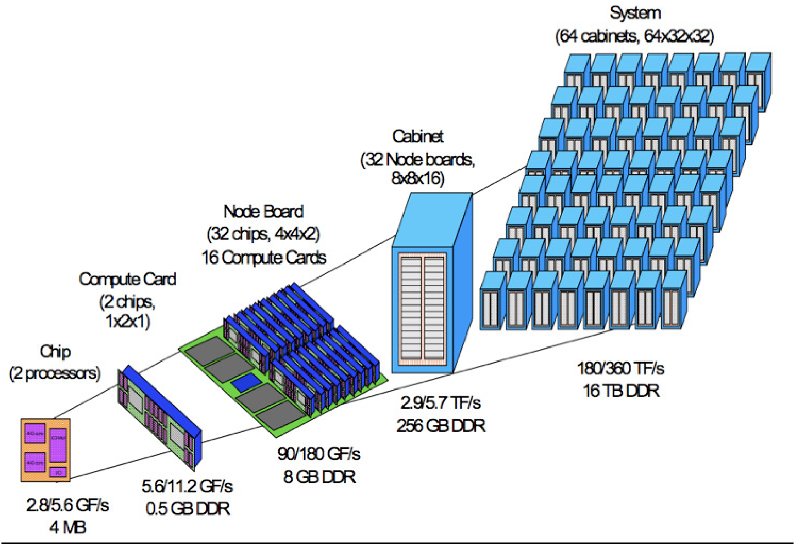
Parallel Computers
Cores with pipelining and short vectors
Multicore processors
Shared memory multiprocessor nodes
Scalable parallel systems

Slide 23
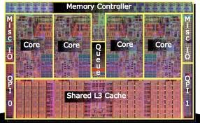
Typical Parallel Machine
Chip/Socket
Core
Core
Core
Core

Slide 24
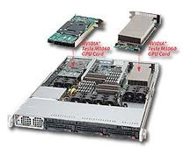
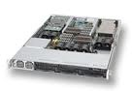
Node/Board
Chip/Socket
GPU …
Chip/Socket
GPU
Chip/Socket
GPU
Core
Core
Core
Core
Core

Slide 25
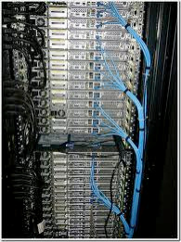
Shared memory programming between processes on a board and
a combination of shared memory and distributed memory programming between nodes and cabinets
Cabinet
Node/Board
…
Node/Board
Node/Board
Chip/Socket
GPU
…
Chip/Socket
GPU
Chip/Socket
GPU
Core
Core
Core
Core
Core

Slide 26
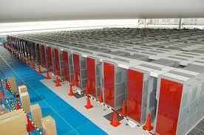
Combination of shared memory and distributed memory programming
Switch
…
Cabinet Cabinet
Cabinet
Node/Board
…
Node/Board
Node/Board
Chip/Socket
GPU
…
Chip/Socket
GPU
Chip/Socket
GPU
Core
Core
Core
Core
Core

Slide 27
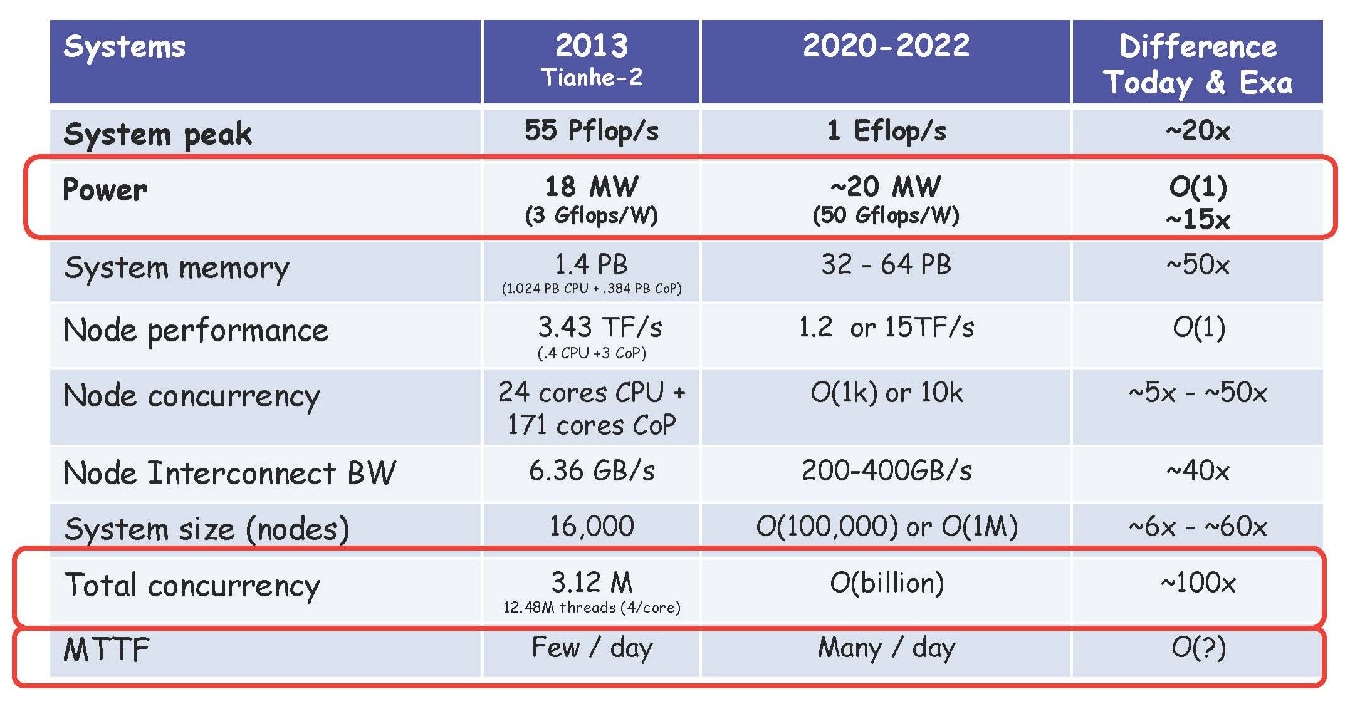
Exascale Systems w/ a cap of $200M and 20MW
Jack Dongarra SC’13

Slide 28
Future Computer Systems
Most likely to be a hybrid design
Think standard multicore chips and accelerators (GPUs)
Today accelerators are attached
Next generation will be more integrated
DOE CORAL (Collaboration of Oak Ridge, Argonne, and Livermore)
Procurement of pre-exascale supercomputers
Summit at ORNL and Sierra at LLNL: Nvidia GPU- accelerated systems based on the IBM OpenPOWER platforms
NVLink is a key building block in these machines, which enables IBM POWER CPUs and Nvidia GPUs to access each other’s memory fast
Aurora at ANL: Intel Xeon Phi Gen 3 with Cray “Shasta” platform

Slide 29
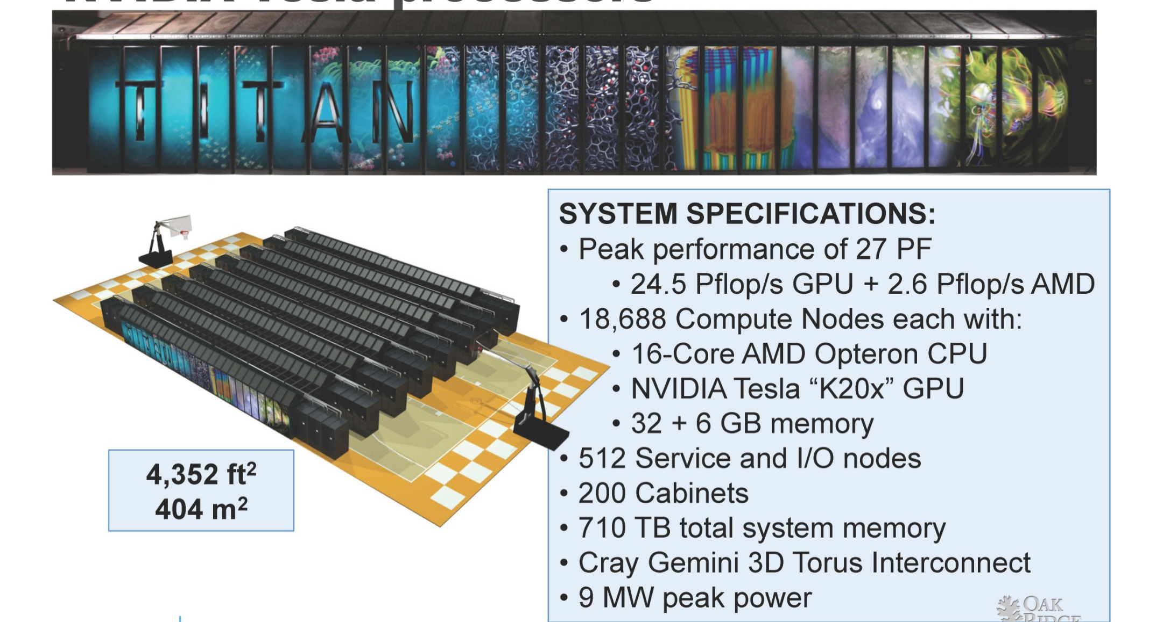
Titan at ORNL: Cray XK7 with AMD Opteron and Nvidia Tesla

Slide 30
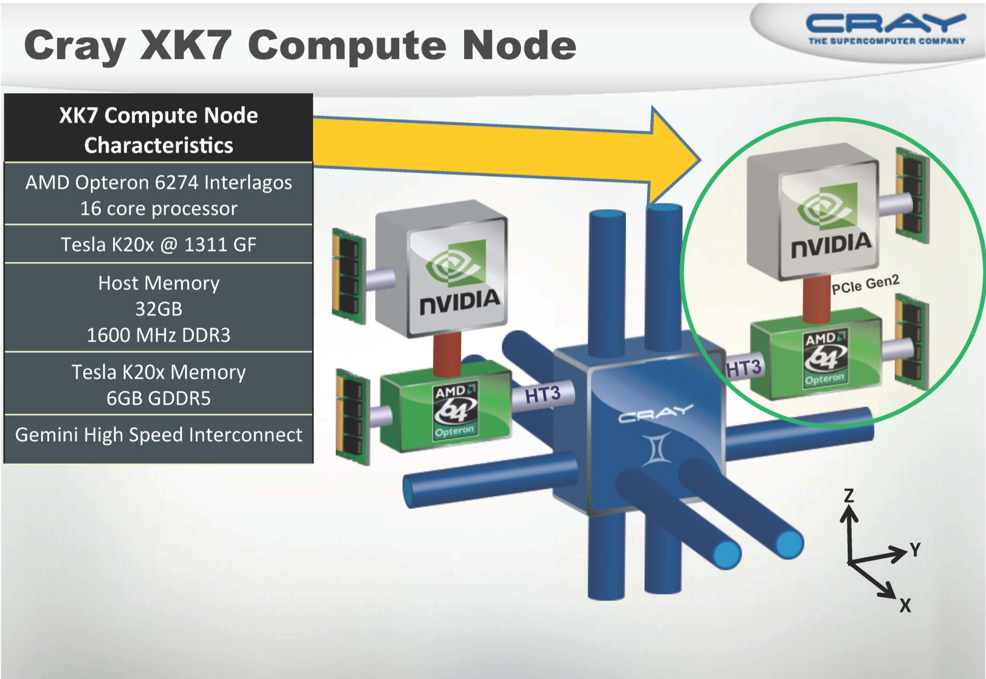

Slide 31
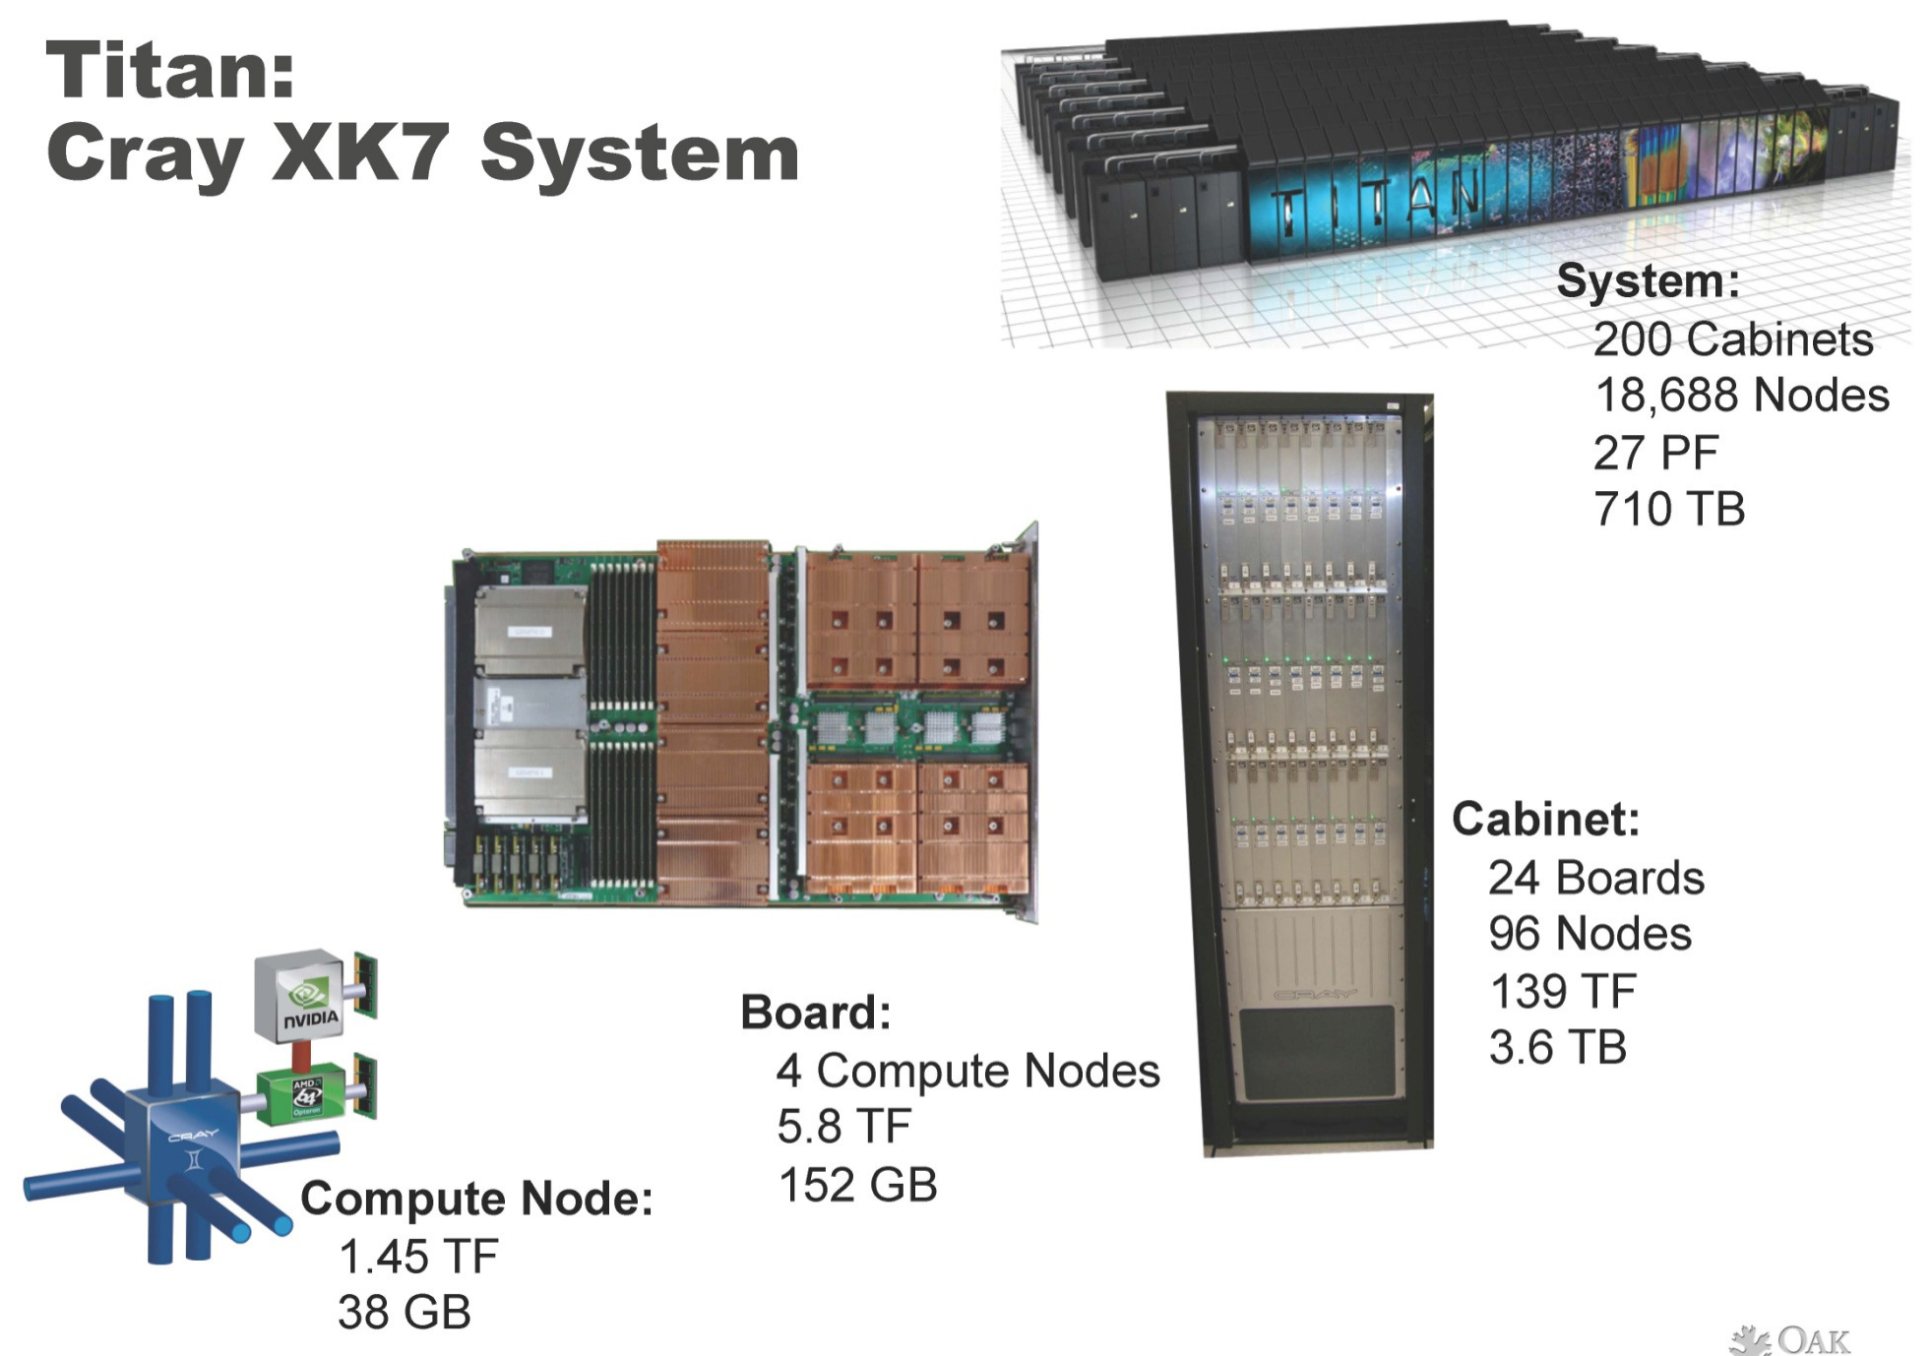

Slide 32
Principles of Parallel Computing
Parallelism and Amdahl’s Law
Finding and exploiting granularity
Preserving data locality
Load balancing
Coordination and synchronization
Performance modeling
All of these things make parallel programming more difficult than sequential programming!

Slide 33
Challenges of Parallelism
“Automatic” parallelism in modern machines
Bit level parallelism – within floating point operations
Instruction level parallelism (ILP) – multiple instructions per clock cycle
Memory system parallelism – overlap of memory accesses with computation
OS parallelism – multiple jobs run in parallel on SMPs
There are limitations to all of these!
To achieve high performance, the programmer needs to identify, schedule and coordinate parallel tasks and data!

Slide 34
Challenges of Parallelism
Applications are often very sophisticated
E.g., adaptive algorithms may require dynamic load balancing
Algorithm development is harder
Complexity of specifying and coordinating concurrent activities
Algorithmic scalability losses
Serialization and load imbalance
Software development is much harder
Lack of development tools and programming models
Subtle program errors: race conditions
Multilevel parallelism is difficult to manage
Communication and/or IO bottlenecks
Rapid pace of change in computer system architecture
A parallel algorithm for one machine may not be a good match for another
Homogeneous multicore processors vs GPGPU
Extreme scale exacerbates inefficiencies

Slide 35
Parallel Systems
All processors will be multi-core
All computers will be massively parallel
All programmers will be parallel programmers
All programs will be parallel programs
The key challenge: how to enable mainstream developers to scale their applications on machines!
Algorithms – scalable, asynchronous, fault tolerant
Programming models and systems
Data management
Runtime system support

Slide 36
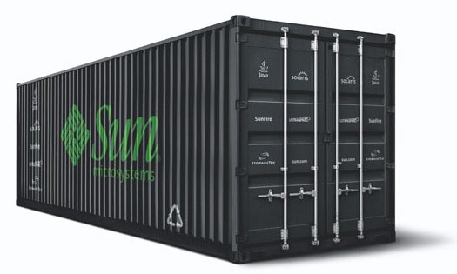
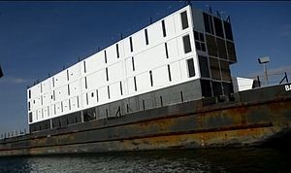
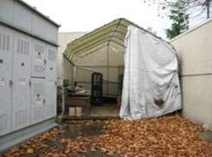
Enterprise Applications
Program = web search, email, map/GIS, …
Computer = 1000’s computers, storage, network
Warehouse-sized facilities and workloads
New datacenter ideas (2007-2008): truck container (Sun), floating (Google), datacenter-in-a-tent (Microsoft)
How to enable innovation in new services w/o first building and capitalizing a large company?

Slide 37
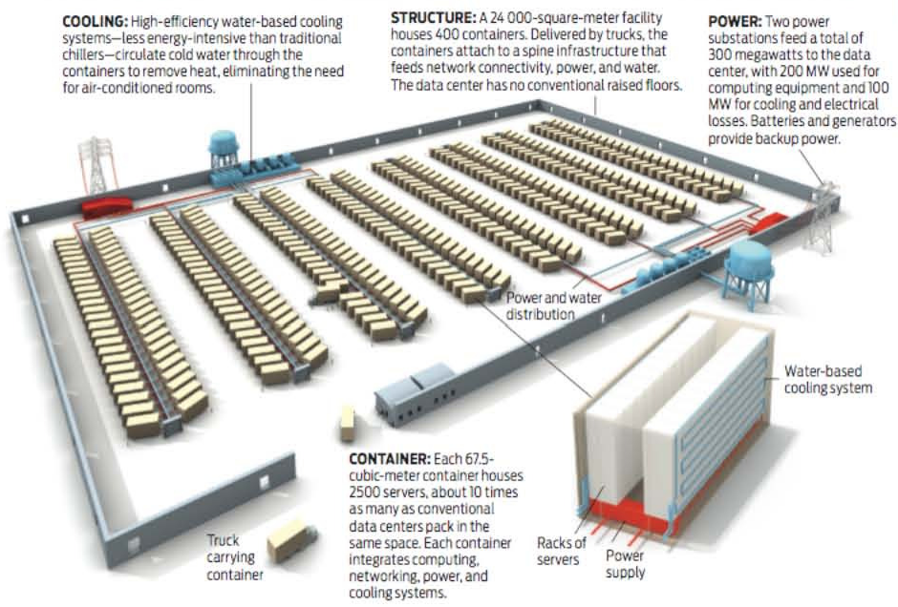

Slide 38
Enterprise Datacenter
A 50-rack data center
X 64 blades per rack
X 2 sockets per blade
X 32 cores per socket
X 10 VMs per core
X 10 Java objects per VM
20,480,000 managed objects!

Slide 39
Enterprise Scalability - Problem
How do you scale up?
Run jobs processing 100’s of terabytes of data
Takes 11 days to read on 1 computer
Need lots of cheap computers
Fixes speed problem (15 min on 1000 computers), but
Reliability issue: large computers fail every day
Need common infrastructure
Must be efficient and reliable

Slide 40
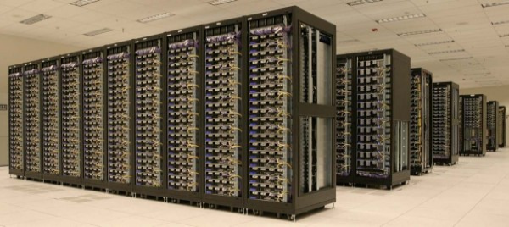
Enterprise Scalability - Solution
Open source Apache Project
Hadoop Core includes
Distributed file systems – distribute data
MapReduce – distribute application
Written in Java
Runs on commodity HW, Linux, Mac OS/X, Windows, …
Hadoop Clusters:
~20,000 machines running Hadoop @Yahoo! Hundreds of thousands of jobs per month

Slide 41
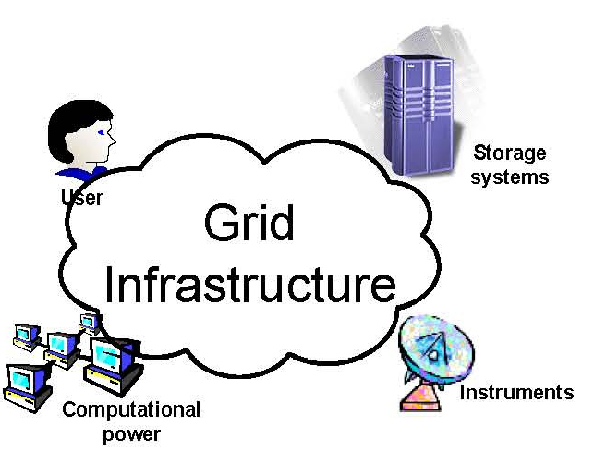
Distributed and Cloud Computing
Peer-to-peer systems
Flexible network of client machines logically connected by an overlay network
Data/computational Grids
Heterogeneous clusters interconnected by high-speed network links over selected resource sites
Key enabler:
Network vs. computer performance
Computer speed doubles every 18 mo. vs. network speed doubles every 9 mo.
Key characteristics:
Sharing data
Distributing computation
Coordinating problem solving
Accessing remove instrumentation

Slide 42


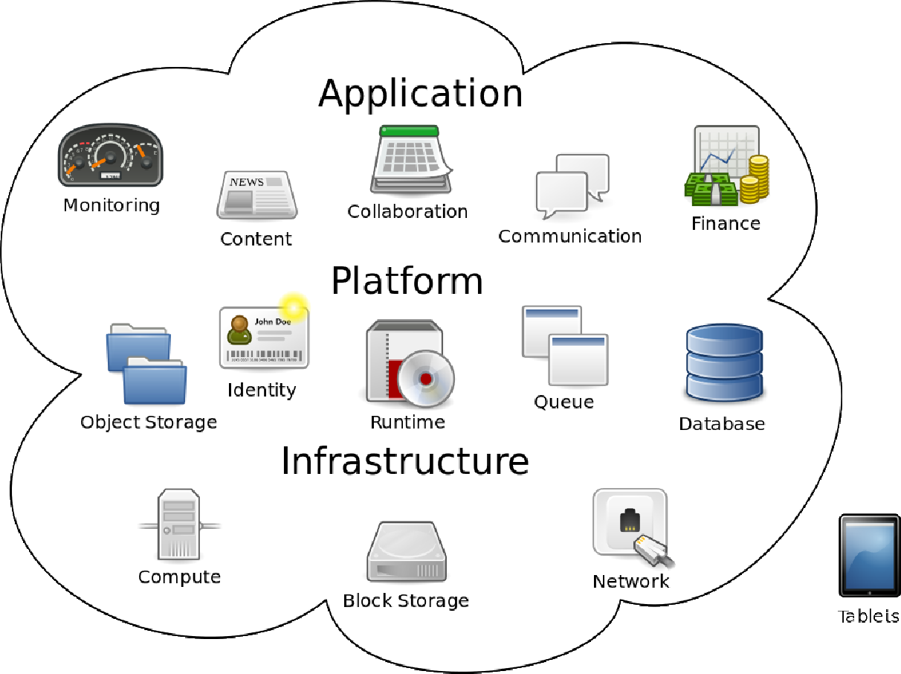


Cloud Computing
Cloud computing is Internet-based computing, whereby shared resources, software and information are provided to computers and other devices on-demand like a public utility (Wikipedia)
A cloud is a computing capability that provides an abstraction between the computing resource and its underlying technical architecture, enabling convenient, on-demand network access to a shared pool of configurable computing resources that can be rapidly provisioned and released with minimal management effort or service provide interaction (NIST)
Deployment models:
Public cloud
Private cloud
Hybrid cloud
CS546

Slide 43
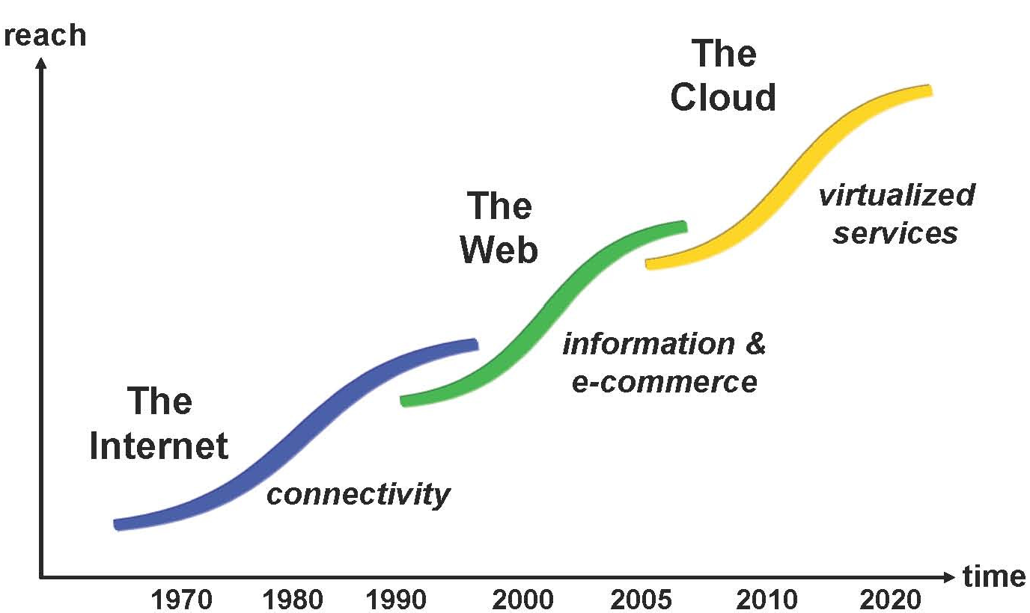
The Cloud Evolution
Ack. Manish Parashar (Rutgers)

Slide 44
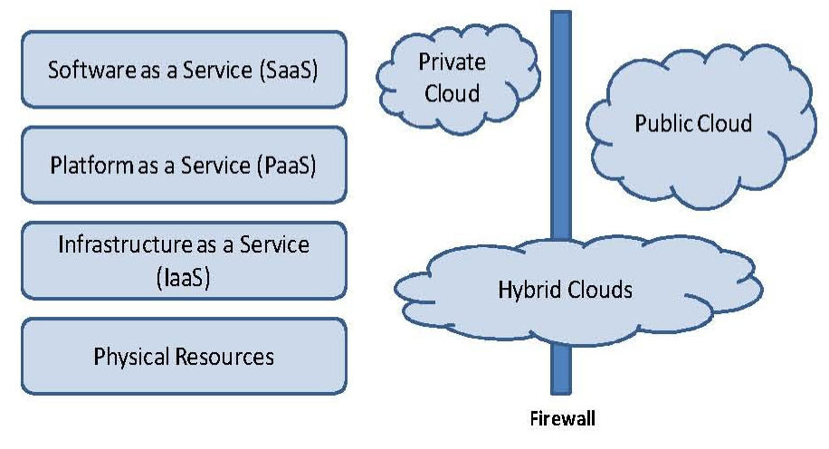
Cloud Stack
➢A seductive abstraction – unlimited resources, always on and accessible !
➢Multiple entry points: SaaS, PaaS, IaaS, HaaS
➢Pay as you go, for what you use!
➢Economy - IT outsourcing, TCO, capital costs, operation costs, …

Slide 45
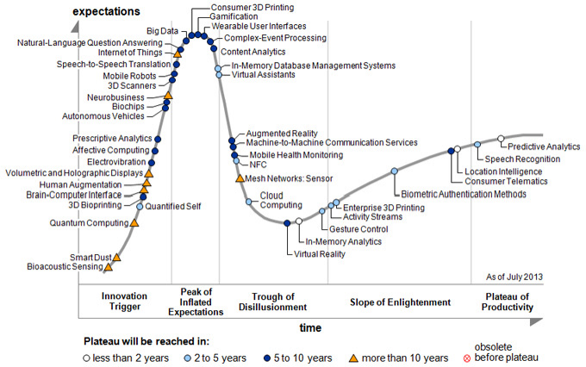

Slide 46
Summary
What is parallel computing
Why parallel computing
Application pull
Technology push
Distributed and cloud computing
Reading:
Kumar – ch 1; Foster – ch 1

